Slide 1
2025 Little League Four Man Rotations
California District 55

Slide 2
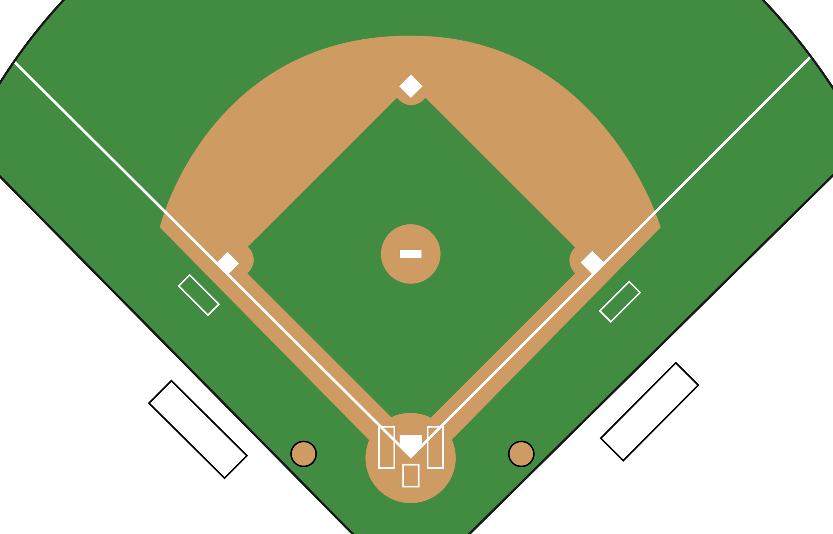
California District 55

Slide 3
California District 55
PHILOSOPHY
PHILOSOPHY
Front load umpires ahead of the runners and plays whenever possible utilizing rotations.
Assign responsibilities and rotations to cover the plays with the highest probabilities in order of priority.
When assigned to cover multiple bases in rotation, the umpire must let the ball take them to the play. The umpire must remember not to overcompensate their position should they be required to make a call on a subsequent play at another assigned base.
Prioritize freedom of movement for fielders and runners so that umpires do not hinder any play as a result of their positioning or rotations. When assigned to cover a single base, this may require U1 / U3 to move into foul territory to observe playing action and adjust their position should a “play” (ball and runner coming together) develop.
Umpire Communication is imperative to ensure proper coverage and rotations. Communication must occur early and continuously throughout the development of the play. Communication should be both audible and visual.

Slide 4
California District 55
PHILOSOPHY
PHILOSOPHY
PHILOSOPHY
Front load umpires ahead of the runners and plays whenever possible utilizing rotations.
Assign responsibilities and rotations to cover the plays with the highest probabilities in order of priority.
When assigned to cover multiple bases in rotation, the umpire must let the ball take them to the play. The umpire must remember not to overcompensate their position should they be required to make a call on a subsequent play at another assigned base.
Prioritize freedom of movement for fielders and runners so that umpires do not hinder any play as a result of their positioning or rotations. When assigned to cover a single base, this may require U1 / U3 to move into foul territory to observe playing action and adjust their position should a “play” (ball and runner coming together) develop.
Umpire Communication is imperative to ensure proper coverage and rotations. Communication must occur early and continuously throughout the development of the play. Communication should be both audible and visual.

Slide 5
California District 55
PHILOSOPHY
PHILOSOPHY
PHILOSOPHY
Front load umpires ahead of the runners and plays whenever possible utilizing rotations.
Assign responsibilities and rotations to cover the plays with the highest probabilities in order of priority.
When assigned to cover multiple bases in rotation, the umpire must let the ball take them to the play. The umpire must remember not to overcompensate their position should they be required to make a call on a subsequent play at another assigned base.
Prioritize freedom of movement for fielders and runners so that umpires do not hinder any play as a result of their positioning or rotations. When assigned to cover a single base, this may require U1 / U3 to move into foul territory to observe playing action and adjust their position should a “play” (ball and runner coming together) develop.
Umpire Communication is imperative to ensure proper coverage and rotations. Communication must occur early and continuously throughout the development of the play. Communication should be both audible and visual.

Slide 6
California District 55
PHILOSOPHY
PHILOSOPHY
PHILOSOPHY
Front load umpires ahead of the runners and plays whenever possible utilizing rotations.
Assign responsibilities and rotations to cover the plays with the highest probabilities in order of priority.
When assigned to cover multiple bases in rotation, the umpire must let the ball take them to the play. The umpire must remember not to overcompensate their position should they be required to make a call on a subsequent play at another assigned base.
Prioritize freedom of movement for fielders and runners so that umpires do not hinder any play as a result of their positioning or rotations. When assigned to cover a single base, this may require U1 / U3 to move into foul territory to observe playing action and adjust their position should a “play” (ball and runner coming together) develop.
Umpire Communication is imperative to ensure proper coverage and rotations. Communication must occur early and continuously throughout the development of the play. Communication should be both audible and visual.

Slide 7
California District 55
PHILOSOPHY
PHILOSOPHY
PHILOSOPHY
Front load umpires ahead of the runners and plays whenever possible utilizing rotations.
Assign responsibilities and rotations to cover the plays with the highest probabilities in order of priority.
When assigned to cover multiple bases in rotation, the umpire must let the ball take them to the play. The umpire must remember not to overcompensate their position should they be required to make a call on a subsequent play at another assigned base.
Prioritize freedom of movement for fielders and runners so that umpires do not hinder any play as a result of their positioning or rotations. When assigned to cover a single base, this may require U1 / U3 to move into foul territory to observe playing action and adjust their position should a “play” (ball and runner coming together) develop.
Umpire Communication is imperative to ensure proper coverage and rotations. Communication must occur early and continuously throughout the development of the play. Communication should be both audible and visual.

Slide 8
California District 55
PHILOSOPHY
PHILOSOPHY
PHILOSOPHY
Front load umpires ahead of the runners and plays whenever possible utilizing rotations.
Assign responsibilities and rotations to cover the plays with the highest probabilities in order of priority.
When assigned to cover multiple bases in rotation, the umpire must let the ball take them to the play. The umpire must remember not to overcompensate their position should they be required to make a call on a subsequent play at another assigned base.
Prioritize freedom of movement for fielders and runners so that umpires do not hinder any play as a result of their positioning or rotations. When assigned to cover a single base, this may require U1 / U3 to move into foul territory to observe playing action and adjust their position should a “play” (ball and runner coming together) develop.
Umpire Communication is imperative to ensure proper coverage and rotations. Communication must occur early and continuously throughout the development of the play. Communication should be both audible and visual.

Slide 9
California District 55
PHILOSOPHY
PHILOSOPHY
Front load umpires ahead of the runners and plays whenever possible utilizing rotations.
Assign responsibilities and rotations to cover the plays with the highest probabilities in order of priority.
When assigned to cover multiple bases in rotation, the umpire must let the ball take them to the play. The umpire must remember not to overcompensate their position should they be required to make a call on a subsequent play at another assigned base.
Prioritize freedom of movement for fielders and runners so that umpires do not hinder any play as a result of their positioning or rotations. When assigned to cover a single base, this may require U1 / U3 to move into foul territory to observe playing action and adjust their position should a “play” (ball and runner coming together) develop.
Umpire Communication is imperative to ensure proper coverage and rotations. Communication must occur early and continuously throughout the development of the play. Communication should be both audible and visual.

Slide 10
California District 55
PHILOSOPHY
Fundamentals
Fundamentals
Umpires must know and execute the 4 Primary Priorities: (1) Priorities / Order of Operations: Fair/Foul, then C/NC, then everything else. (2) Proper Use of Eyes (PUEs); (3) Remain Chest to Ball; and (4) Play Positioning.
Umpires are instructed to shorten up their Initial Pre-Pitch Starting Position:
Never closer than 10-12 feet from the base in front of you.
Never positioned parallel with the fielder in front of you nor in front of that fielder.
Position slightly outside of the fielder’s “halo,” the 2-3 step range 360 degrees around the fielder.
Position must allow you to see the shoe tops of the fielder in front of you for C/NC on a sinking line.
When not in rotation, the umpire is responsible for all calls at their assigned base and will move to Point of Base (PoB) and remain Chest to Ball (CtB) to position for such plays.

Slide 11
California District 55
PHILOSOPHY
Fundamentals
Fundamentals
Umpires must know and execute the 4 Primary Priorities:
(1) Priorities / Order of Operations:
Fair/Foul
Catch / No Catch (C/NC)
then everything else
Proper Use of Eyes (PUEs)
Remain Chest to Ball
Play Positioning.
Umpires are instructed to shorten up their Initial Pre-Pitch Starting Position:
Never closer than 10-12 feet from the base in front of you.
Never positioned parallel with the fielder in front of you nor in front of that fielder.
Position slightly outside of the fielder’s “halo,” the 2-3 step range 360 degrees around the fielder.
Position must allow you to see the shoe tops of the fielder in front of you for C/NC on a sinking line.
When not in rotation, the umpire is responsible for all calls at their assigned base and will move to Point of Base (PoB) and remain Chest to Ball (CtB) to position for such plays.

Slide 12
California District 55
PHILOSOPHY
Fundamentals
Fundamentals
Umpires must know and execute the 4 Primary Priorities: (1) Priorities / Order of Operations: Fair/Foul, then C/NC, then everything else. (2) Proper Use of Eyes (PUEs); (3) Remain Chest to Ball; and (4) Play Positioning.
Umpires are instructed to shorten up their Initial Pre-Pitch Starting Position:
Never closer than 10-12 feet from the base in front of you.
Never positioned parallel with the fielder in front of you nor in front of that fielder.
Position slightly outside of the fielder’s “halo,” the 2-3 step range 360 degrees around the fielder.
Position must allow you to see the shoe tops of the fielder in front of you for C/NC on a sinking line.
When not in rotation, the umpire is responsible for all calls at their assigned base and will move to Point of Base (PoB) and remain Chest to Ball (CtB) to position for such plays.

Slide 13
California District 55
PHILOSOPHY
Fundamentals
Fundamentals
Umpires must know and execute the 4 Primary Priorities: (1) Priorities / Order of Operations: Fair/Foul, then C/NC, then everything else. (2) Proper Use of Eyes (PUEs); (3) Remain Chest to Ball; and (4) Play Positioning.
Umpires are instructed to shorten up their Initial Pre-Pitch Starting Position:
Never closer than 10-12 feet from the base in front of you.
Never positioned parallel with the fielder in front of you nor in front of that fielder.
Position slightly outside of the fielder’s “halo,” the 2-3 step range 360 degrees around the fielder.
Position must allow you to see the shoe tops of the fielder in front of you for C/NC on a sinking line.
When not in rotation, the umpire is responsible for all calls at their assigned base and will move to Point of Base (PoB) and remain Chest to Ball (CtB) to position for such plays.

Slide 14
California District 55
PHILOSOPHY
Fundamentals
Fundamentals
Umpires should use caution when using the Restricted Area:
When responsibilities are multiple, the umpire should use the Restricted Area and remain CtB.
When responsibilities are singular, the umpire should use PoB and remain CtB.

Slide 15
California District 55
PHILOSOPHY
Fundamentals
Restricted Area
RA 3rd Base
RA 1st Base
Fundamentals
Umpires should use caution when using the Restricted Area:
When responsibilities are multiple, the umpire should use the Restricted Area and remain CtB.
When responsibilities are singular, the umpire should use PoB and remain CtB.

Slide 16
California District 55
PHILOSOPHY
Fundamentals
Fundamentals
The appropriate umpire should be out to cover every fly-ball to the outfield. The remaining umpires will rotate appropriately to cover the open base using the Full or Fill rotation as dictated by the position of the runners.
On Fly-Balls Hit to the Outfield, U2’s AOR extends from F7 to F9, straight in and back or towards CF. U1/U3 will cover F9/F7 respectively when moving toward the foul line.
If 2 umpires initially take the same fly-ball, the crew will defer to U2. The other umpire will recover and rotate accordingly. U2 is the “Quarterback” on all fly-balls hit to the outfield.

Slide 17
U2
80%
California District 55
PHILOSOPHY
Fundamentals
U3
10%
U1
10%
Fundamentals
On Fly-Balls Hit to the Outfield, U2’s AOR extends from F7 to F9, straight in and back or towards CF. U1/U3 will cover F9/F7 respectively when moving toward the foul line.
If 2 umpires initially take the same fly-ball, the crew will defer to U2. The other umpire will recover and rotate accordingly. U2 is the “Quarterback” on all fly-balls hit to the outfield.

Slide 18
California District 55
PHILOSOPHY
Fundamentals
Fundamentals
When in rotation, retouches (tag-up attempts) will advance to the umpire positioned at the base ahead of the runner (Exception: R1 Only in Full Rotation = U1 Takes R1’s retouch).
On Fly-Balls Hit in the Infield:
PU will take all C/NC fielded above the waist of the fielder or anytime C/NC occurs on the infield grass.
Open Glove Theory will apply on fly-balls or line-drives hit below the fielder’s waist. The Open Glove Theory means the umpire to whom the fielder’s glove is opening will be responsible for ruling C/NC.

Slide 19
California District 55
PHILOSOPHY
Fundamentals
Fundamentals
To execute the 4-Umpire System effectively, umpires must Think, Read, and Respond:
Think ahead pre-pitch – know what to “DOO:”
Read: With the ball in the air, read the fielders and your partner(s):
Respond: We should have the appropriate umpire out for C/NC on every-fly ball to the outfield:

Slide 20
California District 55
PHILOSOPHY
Fundamentals
Fundamentals
Think ahead pre-pitch – know what to “DOO:”
Move Down to PoB, or
Move Out to cover C/NC in their AOR, or
Move Over to cover another base(s) in rotation.
Pre-Pitch Communication – signal to your partners by pointing to your responsibility given the situation. Signals should be initiated by the Plate Umpire but must be done by all umpires.
Check Fielders – knowing the positioning of fielders to help define each umpire’s AOR.

Slide 21
California District 55
PHILOSOPHY
Fundamentals
Fundamentals
Read: With the ball in the air, read the fielders and your partner(s):
Read the fielder, not the ball. Remember that AOR is determined by the movement of the fielders. Do not look up at the ball and be sure to check the position of fielders each pitch.
Read your partners and communicate. We defer to U2 and can use a non-verbal “stop hand” to communicate with one another.

Slide 22
California District 55
PHILOSOPHY
Fundamentals
Fundamentals
Respond: We should have the appropriate umpire out for C/NC on every-fly ball to the outfield:
Commit aggressively on every fly-ball to the outfield in your AOR. “Leave no doubt that you are out.”
Run parallel to the fielder attempting to catch the ball to avoid being straight-lined.
Get as far as the play allows you and get set before the fielder attempts to make the catch.
Timing & Proper Use of Eyes to confirm firm and secure possession and voluntary and intentional release BEFORE making a signal.
Go out and stay out (unless returning to assist in a rundown, waiting for the play to go away from you to call yourself into the rundown).

Slide 23
California District 55
PHILOSOPHY
Fundamentals
Fundamentals
Remember
Think, Read, and Respond

Slide 24
California District 55
In the Field Positioning

Slide 25
California District 55
Between Innings
Between Innings

Slide 26
California District 55
Between Innings
Between Innings

Slide 27
California District 55
Between Innings
On the Thrown Down

Slide 28
California District 55
Fair / Foul Responsibilities
PU
PU has the call on both lines up to but not including the front edge of the base.
This includes any batted ball that stops short of or fielded in front of either 1B or 3B.
PU will assume the entire foul line when U1 or U3 abandon the line.
PU shall “hold the line” at PoP when not in rotation.
U1 / U3
U1 / U3 has the call from the front edge of base and beyond.
This includes any batted ball that is bounding in the air, or on the ground, or is fielded even with the front edge or beyond the base.
If abandons the line, will never come back to make a F/F decision.
Will either be on the line to call F/F or move to Po1 if abandoning.

Slide 29
BATTED BALLS HIT OR FIELDED IN THE INFIELD
California District 55
No Runner On

Slide 30
BATTED BALLS HIT OR FIELDED IN THE INFIELD
California District 55
No Runners On
No Runner On

Slide 31
BATTED BALLS HIT OR FIELDED IN THE INFIELD
California District 55
No Runners On
Fundamentals
No Runner On

Slide 32
BATTED BALLS HIT OR FIELDED IN THE INFIELD
California District 55
No Runners On
Fundamentals
No Runner On

Slide 33
BATTED BALLS HIT OR FIELDED IN THE INFIELD
California District 55
No Runners On
Fundamentals
Anytime Runners On

Slide 34
BATTED BALLS HIT OR FIELDED IN THE INFIELD
California District 55
No Runners On
Fundamentals
Anytime Runners On
Notes:
PU: PU will handle all responsibilities in order of priority from PoP.
With R3, PU may be blocked for F/F between HP and 3B. This is a “Pinch” situation, and F/F can be passed to U3.
Responsible for the call on a tag attempt on the BR prior to the Runner’s Lane.
Provides information to U1, if requested.
Remains PoP to use as starting position for potential play(s) at HP.
U1: Reads the ball and moves to establish angle for potential plays at 1B.
Force Play “Set” position can be either 90 degrees from the origin of the throw or closer to the line.
U1 will adjust with F3 if the play evolves into a tag-play.
U2: Reads the ball and moves to remain CtB on the outside of the diamond.
On a force play at 2B, U2 must move into position to see all elements of the play and drift for to observe subsequent infractions
U2 will use wedge theory to position for tag plays at 2B.
U3: Reads the ball and moves to Po3.
U3 must “own the real estate” on the topside of the base between the foul line and the coach’s box.
U3 will use wedge theory to position for tag-plays at 3B.

Slide 35
BATTED BALLS HIT OR FIELDED IN THE INFIELD
California District 55
No Runners On
Fundamentals
Anytime Runners On
Notes:
PU: PU will handle all responsibilities in order of priority from PoP.
With R3, PU may be blocked for F/F between HP and 3B. This is a “Pinch” situation, and F/F can be passed to U3.
Responsible for the call on a tag attempt on the BR prior to the Runner’s Lane.
Provides information to U1, if requested.
Remains PoP to use as starting position for potential play(s) at HP.
U1: Reads the ball and moves to establish angle for potential plays at 1B.
Force Play “Set” position can be either 90 degrees from the origin of the throw or closer to the line.
U1 will adjust with F3 if the play evolves into a tag-play.
U2: Reads the ball and moves to remain CtB on the outside of the diamond.
On a force play at 2B, U2 must move into position to see all elements of the play and drift for to observe subsequent infractions
U2 will use wedge theory to position for tag plays at 2B.
U3: Reads the ball and moves to Po3.
U3 must “own the real estate” on the topside of the base between the foul line and the coach’s box.
U3 will use wedge theory to position for tag-plays at 3B.

Slide 36
Clean Base Hit to the Outfield
California District 55
No Runners On
Fundamentals
All Situations

Slide 37
Clean Base Hit to the Outfield
California District 55
No Runners On
Fundamentals
All Situations
Notes:
PU: PU will handle all responsibilities in order of priority from PoP,
Remains at PoP and adjusts from there for potential plays at HP.
U1: Reads the ball and moves to Po1, CtB.
U1 must “own the real estate” on the topside of the base between the foul line and the coach’s box.
U1 will use wedge theory to position for tag-plays at 1B.
U2: Reads the ball as a clean base hit to the outfield and moves to Po2 opposite the throw.
Reads the runners, fielders, and play to position for runner sliding at U2.
U3: Reads the ball and moves to Po3, CtB.
U3 must “own the real estate” on the topside of the base between the foul line and the coach’s box.
U3 will use wedge theory to position for tag-plays at 3B.

Slide 38
California District 55
Fly Ball to the Outfield
Types of Rotations

Slide 39
California District 55
Types of Rotations
Fly Ball to the Outfield
In our 4-Umpire System for the 60-Foot Diamond, the following is a list of the three types of rotations that will be utilized in this system:
• FULL ROTATION – used with NRiSP (NRO or R1 Only) when U2 or U3 leaves to cover C/NC.
o Called the “Full Rotation” because everyone moves.
• FILL ROTATION – used with RiSP when U2 or U3 leaves to cover C/NC. o Called the “Fill Rotation” because either U2 or U3 fills the vacancy when U2/U3 leaves for C/NC.
• U2 FILL – used anytime U1 leaves to cover C/NC.
o Called the “U2 Fill” because U2 will fill the RA whenever U1 leaves to cover C/NC.

Slide 40
California District 55
Full Rotation
Fly Ball to the Outfield
• FULL ROTATION – used with NRiSP (NRO or R1 Only) when U2 or U3 leaves to cover C/NC.
o Called the “Full Rotation” because everyone moves.
Movements: Everyone Moves in a Clockwise Rotation
• PU: Moves to Cover 3B in foul territory and remains in foul territory to apply wedge positioning for tag plays at 3B.
• U1: Observes the Batter-Runner’s Touch and then releases to cover HP at PoP with U2 or U3 picking up the BR back into 1B.
• U2: Leaves to cover C/NC in AOR OR moves to Po2 opposite the throw to position for tag plays at 2B (U2 will pick-up the BR back into 1B after U1 releases to HP) with U3 out.
• U3: Leaves to cover C/NC in AOR OR moves to Po2, opposite the throw, while remaining CtB to cover all plays at 2B (U3 will pick-up the BR back into 1B after U1 releases to HP) with U2 out.

Slide 41
California District 55
Full Rotation
U2 Out
U2
Out for
C / NC
Notes:
FULL ROTATION – used with NRiSP (NRO or R1 Only) when U2 or U3 leaves to cover C/NC.
o Called the “Full Rotation” because everyone moves.
Movements: Everyone Moves in a Clockwise Rotation
• PU: Moves to Cover 3B in foul territory and remains in foul territory to apply wedge positioning for tag plays at 3B.
• U1: Observes the Batter-Runner’s Touch and then releases to cover HP at PoP with U2 or U3 picking up the BR back into 1B.
• U2: Leaves to cover C/NC in AOR OR moves to Po2 opposite the throw to position for tag plays at 2B (U2 will pick-up the BR back into 1B after U1 releases to HP) with U3 out.
• U3: Leaves to cover C/NC in AOR OR moves to Po2, opposite the throw, while remaining CtB to cover all plays at 2B (U3 will pick-up the BR back into 1B after U1 releases to HP) with U2 out.

Slide 42
California District 55
Full Rotation
U2 Out
U2
Out for
C / NC
Notes:
FULL ROTATION – used with NRiSP (NRO or R1 Only) when U2 or U3 leaves to cover C/NC.
o Called the “Full Rotation” because everyone moves.
Movements: Everyone Moves in a Clockwise Rotation
• PU: Moves to Cover 3B in foul territory and remains in foul territory to apply wedge positioning for tag plays at 3B.
• U1: Observes the Batter-Runner’s Touch and then releases to cover HP at PoP with U2 or U3 picking up the BR back into 1B.
• U2: Leaves to cover C/NC in AOR OR moves to Po2 opposite the throw to position for tag plays at 2B (U2 will pick-up the BR back into 1B after U1 releases to HP) with U3 out.
• U3: Leaves to cover C/NC in AOR OR moves to Po2, opposite the throw, while remaining CtB to cover all plays at 2B (U3 will pick-up the BR back into 1B after U1 releases to HP) with U2 out.

Slide 43
California District 55
Full Rotation
U2 Out
U2
Out for
C / NC
Notes:
FULL ROTATION – used with NRiSP (NRO or R1 Only) when U2 or U3 leaves to cover C/NC.
o Called the “Full Rotation” because everyone moves.
Movements: Everyone Moves in a Clockwise Rotation
• PU: Moves to Cover 3B in foul territory and remains in foul territory to apply wedge positioning for tag plays at 3B.
• U1: Observes the Batter-Runner’s Touch and then releases to cover HP at PoP with U2 or U3 picking up the BR back into 1B.
• U2: Leaves to cover C/NC in AOR OR moves to Po2 opposite the throw to position for tag plays at 2B (U2 will pick-up the BR back into 1B after U1 releases to HP) with U3 out.
• U3: Leaves to cover C/NC in AOR OR moves to Po2, opposite the throw, while remaining CtB to cover all plays at 2B (U3 will pick-up the BR back into 1B after U1 releases to HP) with U2 out.

Slide 44
California District 55
Full Rotation
U3 Out
U3
Out for
C / NC
Notes:
FULL ROTATION – used with NRiSP (NRO or R1 Only) when U2 or U3 leaves to cover C/NC.
o Called the “Full Rotation” because everyone moves.
Movements: Everyone Moves in a Clockwise Rotation
• PU: Moves to Cover 3B in foul territory and remains in foul territory to apply wedge positioning for tag plays at 3B.
• U1: Observes the Batter-Runner’s Touch and then releases to cover HP at PoP with U2 or U3 picking up the BR back into 1B.
• U2: Leaves to cover C/NC in AOR OR moves to Po2 opposite the throw to position for tag plays at 2B (U2 will pick-up the BR back into 1B after U1 releases to HP) with U3 out.
• U3: Leaves to cover C/NC in AOR OR moves to Po2, opposite the throw, while remaining CtB to cover all plays at 2B (U3 will pick-up the BR back into 1B after U1 releases to HP) with U2 out.

Slide 45
California District 55
Full Rotation
U3 Out
U3
Out for
C / NC
Notes:
FULL ROTATION – used with NRiSP (NRO or R1 Only) when U2 or U3 leaves to cover C/NC.
o Called the “Full Rotation” because everyone moves.
Movements: Everyone Moves in a Clockwise Rotation
• PU: Moves to Cover 3B in foul territory and remains in foul territory to apply wedge positioning for tag plays at 3B.
• U1: Observes the Batter-Runner’s Touch and then releases to cover HP at PoP with U2 or U3 picking up the BR back into 1B.
• U2: Leaves to cover C/NC in AOR OR moves to Po2 opposite the throw to position for tag plays at 2B (U2 will pick-up the BR back into 1B after U1 releases to HP) with U3 out.
• U3: Leaves to cover C/NC in AOR OR moves to Po2, opposite the throw, while remaining CtB to cover all plays at 2B (U3 will pick-up the BR back into 1B after U1 releases to HP) with U2 out.

Slide 46
California District 55
Full Rotation
U3 Out
U3
Out for
C / NC
Notes:
FULL ROTATION – used with NRiSP (NRO or R1 Only) when U2 or U3 leaves to cover C/NC.
o Called the “Full Rotation” because everyone moves.
Movements: Everyone Moves in a Clockwise Rotation
• PU: Moves to Cover 3B in foul territory and remains in foul territory to apply wedge positioning for tag plays at 3B.
• U1: Observes the Batter-Runner’s Touch and then releases to cover HP at PoP with U2 or U3 picking up the BR back into 1B.
• U2: Leaves to cover C/NC in AOR OR moves to Po2 opposite the throw to position for tag plays at 2B (U2 will pick-up the BR back into 1B after U1 releases to HP) with U3 out.
• U3: Leaves to cover C/NC in AOR OR moves to Po2, opposite the throw, while remaining CtB to cover all plays at 2B (U3 will pick-up the BR back into 1B after U1 releases to HP) with U2 out.

Slide 47
California District 55
Fill Rotation
RISP
• FILL ROTATION – used with RiSP when U2 or U3 leaves to cover C/NC. o Called the “Fill Rotation” because either U2 or U3 fills the vacancy when U2/U3 leaves for C/NC.
Movements: One Umpire (U2/U3) FILLS the Vacancy
• PU: Stays at HP and uses PoP.
• U1: Moves to Po1 and is the “crew saver” to use Proper Use of Eyes (PUEs) to observe all action.
• U2: Leaves to cover C/NC OR moves to RA to cover plays at 2B and 3B with U3 out. U2 will slip to the outside once responsibilities become singular.
• U3: Leaves to cover C/NC in AOR OR moves to RA to cover plays at 2B and 3B with U2 out. U3 will slip to the outside once responsibilities become singular.

Slide 48
California District 55
Fill Rotation
U2 Out
U2
Out for
C / NC
Notes:
FULL ROTATION – used with NRiSP (NRO or R1 Only) when U2 or U3 leaves to cover C/NC.
o Called the “Full Rotation” because everyone moves.
Movements: Everyone Moves in a Clockwise Rotation
• PU: Moves to Cover 3B in foul territory and remains in foul territory to apply wedge positioning for tag plays at 3B.
• U1: Observes the Batter-Runner’s Touch and then releases to cover HP at PoP with U2 or U3 picking up the BR back into 1B.
• U2: Leaves to cover C/NC in AOR OR moves to Po2 opposite the throw to position for tag plays at 2B (U2 will pick-up the BR back into 1B after U1 releases to HP) with U3 out.
• U3: Leaves to cover C/NC in AOR OR moves to Po2, opposite the throw, while remaining CtB to cover all plays at 2B (U3 will pick-up the BR back into 1B after U1 releases to HP) with U2 out.

Slide 49
California District 55
Fill Rotation
U2 Out
U2
Out for
C / NC
Notes:
FULL ROTATION – used with NRiSP (NRO or R1 Only) when U2 or U3 leaves to cover C/NC.
o Called the “Full Rotation” because everyone moves.
Movements: Everyone Moves in a Clockwise Rotation
• PU: Moves to Cover 3B in foul territory and remains in foul territory to apply wedge positioning for tag plays at 3B.
• U1: Observes the Batter-Runner’s Touch and then releases to cover HP at PoP with U2 or U3 picking up the BR back into 1B.
• U2: Leaves to cover C/NC in AOR OR moves to Po2 opposite the throw to position for tag plays at 2B (U2 will pick-up the BR back into 1B after U1 releases to HP) with U3 out.
• U3: Leaves to cover C/NC in AOR OR moves to Po2, opposite the throw, while remaining CtB to cover all plays at 2B (U3 will pick-up the BR back into 1B after U1 releases to HP) with U2 out.

Slide 50
California District 55
Fill Rotation
U3 Out
U3
Out for
C / NC
Notes:
FULL ROTATION – used with NRiSP (NRO or R1 Only) when U2 or U3 leaves to cover C/NC.
o Called the “Full Rotation” because everyone moves.
Movements: Everyone Moves in a Clockwise Rotation
• PU: Moves to Cover 3B in foul territory and remains in foul territory to apply wedge positioning for tag plays at 3B.
• U1: Observes the Batter-Runner’s Touch and then releases to cover HP at PoP with U2 or U3 picking up the BR back into 1B.
• U2: Leaves to cover C/NC in AOR OR moves to Po2 opposite the throw to position for tag plays at 2B (U2 will pick-up the BR back into 1B after U1 releases to HP) with U3 out.
• U3: Leaves to cover C/NC in AOR OR moves to Po2, opposite the throw, while remaining CtB to cover all plays at 2B (U3 will pick-up the BR back into 1B after U1 releases to HP) with U2 out.

Slide 51
California District 55
Fill Rotation
U3 Out
U2
Out for
C / NC
Notes:
FULL ROTATION – used with NRiSP (NRO or R1 Only) when U2 or U3 leaves to cover C/NC.
o Called the “Full Rotation” because everyone moves.
Movements: Everyone Moves in a Clockwise Rotation
• PU: Moves to Cover 3B in foul territory and remains in foul territory to apply wedge positioning for tag plays at 3B.
• U1: Observes the Batter-Runner’s Touch and then releases to cover HP at PoP with U2 or U3 picking up the BR back into 1B.
• U2: Leaves to cover C/NC in AOR OR moves to Po2 opposite the throw to position for tag plays at 2B (U2 will pick-up the BR back into 1B after U1 releases to HP) with U3 out.
• U3: Leaves to cover C/NC in AOR OR moves to Po2, opposite the throw, while remaining CtB to cover all plays at 2B (U3 will pick-up the BR back into 1B after U1 releases to HP) with U2 out.

Slide 52
California District 55
U2 Fill
Anytime U1 Goes Out
U2 FILL – used anytime U1 leaves to cover C/NC.
o Called the “U2 Fill” because U2 will fill the RA whenever U1 leaves to cover C/NC.
Movements: Results when U1 leaves to cover C/NC:
• PU: Stays at HP and uses PoP.
• U1: Leaves to cover C/NC.
• U2: fills to the right side of the infield in the RA and is responsible for all plays at 1B and 2B. U2 will slip to the outside once responsibilities become singular.
• U3: Moves to Po3 to position for tag plays at 3B.

Slide 53
California District 55
U2 Fill
Anytime U1 Goes Out
U1
Out for
C / NC

Slide 54
California District 55
U2 Fill
Anytime U1 Goes Out
U1
Out for
C / NC

Slide 55
California District 55

Slide 56
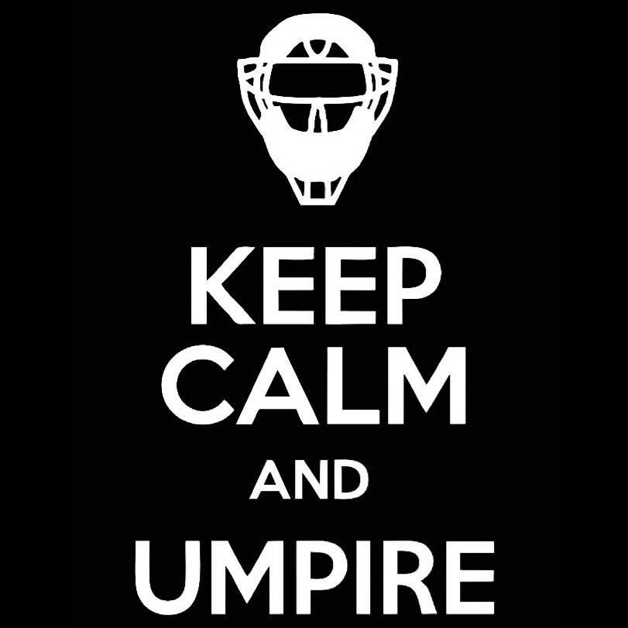
California District 55

Slide 57
California District 55
You can't handle the plate! Coach, we work in a ballpark that has fences. And those fences have to be guarded by men with plate shoes. Who's gonna do it? You?
You, Coach Weinberg? I have a greater responsibility than you can possibly fathom. You weep about balls and strikes and you curse the Men in Blue. You have that luxury.
You have the luxury of not knowing what I know: that interference calls, while tragic, probably get outs. And my existence, while grotesque and incomprehensible to you, gets outs...You don't want the truth.
Because deep down, in places you don't talk about at parties, you want me on that plate. You need me on that plate.

